Slide 1
AI-Powered Smart Service Marketplace with Intelligent Discovery and Dynamic Pricing Models
R26-IT-090
PP-2

Slide 2

IT22551320 | BANDARA W A M S
Intelligent Service Discovery and Intent Recognition System
IT22551320 | Bandara W A M S | R26-IT-090

Slide 3
Intelligent Service Discovery and Intent Recognition System
How the Solution Addresses the Sub-Problem
Homeowners describe faults in informal Singlish (e.g., "watura bata pupurala") keyword-based search completely fails on these inputs
Output: structured { workerCategory} payload passed to the Recommendation Engine
User Requirements Addressed
Accept unstructured Singlish/English queries no technical keywords required
Classify query into the correct worker category (Plumber, Electrician, Carpenter, etc.)
Response returned under 1s
IT22551320 | Bandara W A M S | R26-IT-090

Slide 4
Intelligent Service Discovery and Intent Recognition System
Design Excellence / Contribution
First domain-specific Singlish NLP classifier for the Sri Lankan household service sector
Trained on a custom, locally synthesised Singlish dataset - accurate, affordable, and privacy-compliant
Used pretrained model from HuggingFace
paraphrase-multilingual-MiniLM-L12-v2
User Feedback on Prototype
Tested with 10 participants
5/10 successfully retrieved the correct worker category using natural Singlish queries
Feedback: struggles with some phrases that used in different categories – failing to predict correct category
IT22551320 | Bandara W A M S | R26-IT-090

Slide 5

IT22283658 | SHIWANTHIKA M.M
Intelligent Worker Recommendation Engine
IT22283658 | Shiwanthika M M | R26-IT-090

Slide 6

Intelligent Worker Recommendation Engine
How the Solution Addresses the Sub-Problem
Users waste time calling multiple workers and often hire someone unavailable, far away, or unqualified for the specific task
4-step Hybrid Pipeline: Gatekeeper Filter → Normalize equation → Top 10 Ranking
Historical Score based on NVQ qualification level (3–7) and past average completion time — category-specific
Final score blended with live GPS distance and Component 3's Trust Score using a weighted formula
User Requirements Addressed
Return ranked Top 10 suitable, available workers for the requested category
Score workers based on NVQ level and category-specific job history
Penalise workers who are geographically far at the time of request
Scoring must be strictly category-specific (plumbing score ≠ electrical score)
Ranked list returned within 2 seconds
IT22283658 | Shiwanthika M M | R26-IT-090

Slide 7

IT22643704 | Wijebandara W.N.S.K
Intelligent Service Discovery and Intent Recognition System

Slide 8
Intelligent Service Discovery and Intent Recognition System
Problem & Proposed Solution
Automated Review Credibility & Sentiment Analysis Module Problem Existing platforms mainly rely on star ratings Star ratings alone cannot fully represent customer experience Some systems allow unverified reviews Fake or misleading reviews reduce trust Existing sentiment models struggle with Singlish reviews Proposed Solution
Develop an AI-based module that:
Analyzes verified customer reviews
Uses sentiment analysis + star ratings
Generates worker credibility scores
Supports Singlish customer reviews
IT22643704 | Wijebandara W.N.S.K | R26-IT-090

Slide 9
Intelligent Service Discovery and Intent Recognition System
System Workflow & Calculation
How the System Works
Customer completes service transaction
Customer submits :Text review Star rating (1–5)
NLP preprocessing:Lowercasing TokenizationStop-word removal Sentiment model classifies
review:
Positive / Negative System calculates: Sentiment Score Normalized Star Rating Final credibility score is generated Credibility Formula Sentiment Score Positive Reviews/Total Reviews Normalized RatingAverage
Rating/5Final ScoreCredibility
Score=w1×Sentiment Score+w2×Normalized Rating
Example:(0.6×0.75)+(0.4×0.86)=0.79
Novelty, Technologies & Expected Outcome
Verified review mechanism
Sentiment-based credibility evaluation
Singlish-aware review dataset
Category-based credibility scores
Example:Plumbing Score → 0.92
Electrical Score → 0.55
Technologies Used
Natural Language Processing (NLP)Machine Learning Sentiment AnalysisPython / Scikit-learnNLTK / spaCyMySQL / PostgreSQLExpected OutcomeImprove trust in the platformHelp users identify reliable workersSupport fair worker reputationImprove transparency in worker evaluation
IT22643704 | Wijebandara W.N.S.K | R26-IT-090

Slide 10
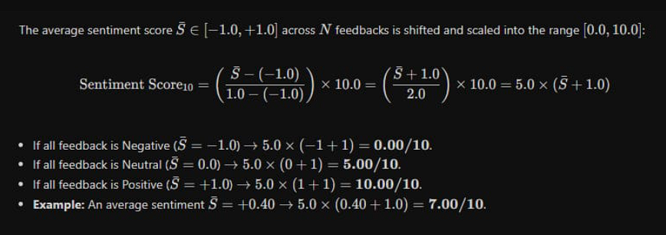
Star rating
(n/5)x10x60%
Sentiment rating

Slide 11

IT22137982|A.J.T.M. Kumara
Intelligent Dynamic Fare Estimation System

Slide 12
Intelligent Dynamic Fare Estimation System
Dynamic Context-Aware Pricing Engine: Automates technician travel cost estimation by integrating real-time routing distance, traffic congestion metrics via Google Maps, and adverse weather data via OpenWeatherMap.
Economic Resilience with Fuel Indexing: Safeguards service worker margins against macroeconomic volatility by dynamically indexing distance rates to real-time Sri Lankan fuel benchmarks (CEYPETCO rates).
Cloud-Native & Decoupled Architecture: Built as an independent, scalable RESTful microservice deployed on Render (Gunicorn/Flask), enabling seamless cross-platform integration with Flutter mobile applications and external systems.
AI-Driven Transparent Pricing: An automated machine learning pricing engine that accurately estimates fair, localized repair price ranges (minimum to maximum) across diverse home maintenance services, eliminating unfair overcharging and guesswork for users.
Instant End-to-End Service Matching: A responsive, full-stack platform featuring dynamic service discovery, low-latency REST APIs, and seamless multi-device accessibility to connect homeowners with verified local technicians efficiently.
IT22137982 | Kumara A.J.T.M| R26-IT-090

